Slide 1

  2018 Benefits Review
  Open Enrollment October 2 - 13
  Presenter:
  Lynne Nelson, Human Resource Management

Slide 2

Agenda
Benefit updates - BellinBenefits.org
Health Plan
Dental Plan
Vision Plan
Flex Spend
Voluntary Life Insurance
Lawson - Online Enrollment
Key dates

Slide 3

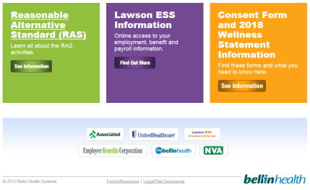
  All 2018 Benefit
  Information now
  available online at
  BellinBenefits.org!
  Benefit enrollment information
  Benefit Summaries
  Benefit Forms
  Important Dates
  Efficiency: Print only
  what you need.
(Click here)

Slide 4
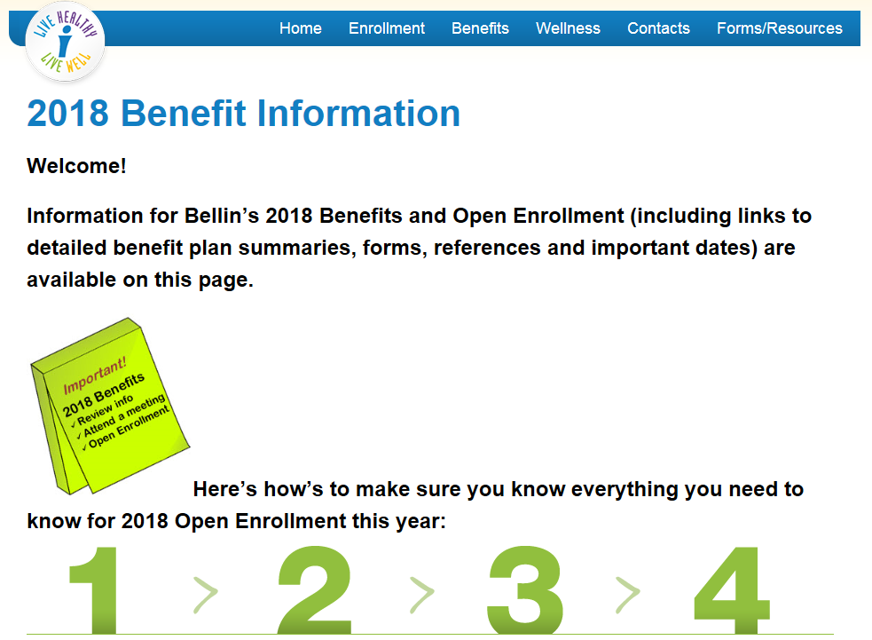
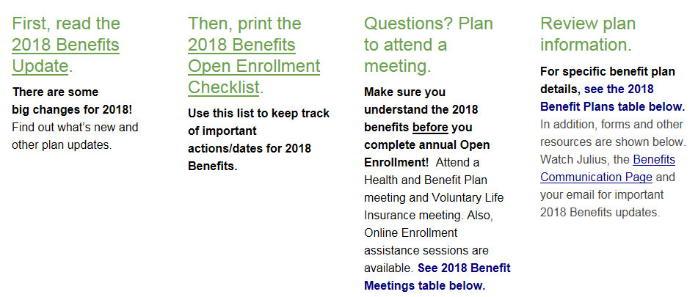
Follow these steps, so you don’t miss any information.
1) Read the 2018 Benefits Update (overview of the 2018 Benefits).
2) Use 2018 Benefits Open Enrollment Checklist to track what you need to do and when.
Also included on this page is information about:
Meetings (for 2018 Health Plan Benefits, Voluntary Life Insurance and Open Enrollment Assistance)
2018 Benefit Plan Details (including coverages and premiums)
Annual Enrollment information and Benefit Forms
(Scroll down for more information)

Slide 5
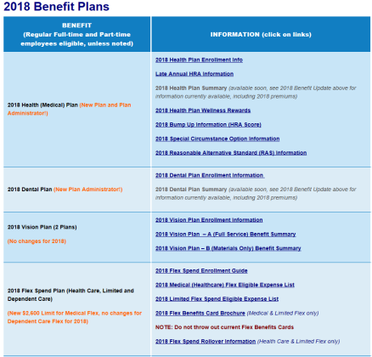
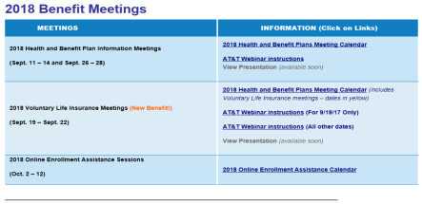
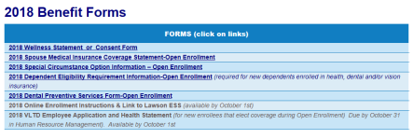
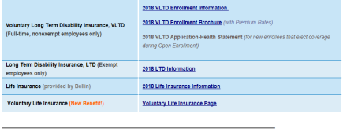
Links to 2018 benefit meetings, information and forms are located in these tables on the 2018 Benefit Information Page.

Slide 6
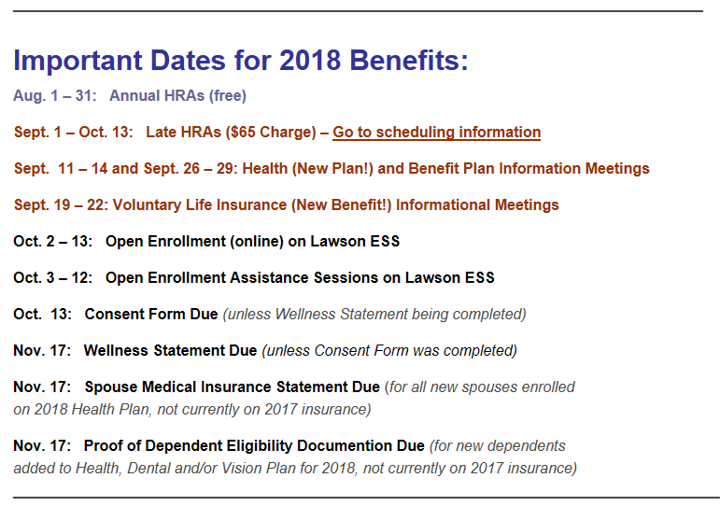
2018 Benefit Information Page
  List of important dates is also shown for quick reference.

Slide 7
2018 Benefits Review

Slide 8
2018 Benefits Review
2016 Health Plan Cost: $27,962,540
$5.5 million over forecast
2017 Health Plan Cost: $14,468,880 (to-date)
$2.17 million over forecast

Slide 9


2018 Benefits Review
A new relationship
  What’s this all about?
What will be changing for us?
  Health and Dental Plans
    Plan design/Plan administration
Why is this change happening?
  Rising costs, large claims
  Movement toward better plan management
2018 Premiums
  Changes/Increase necessary

Slide 10
2018 Benefits Review

Slide 11


2018 Health Plan
New Plan with HealthPartners for 2018!
What is not changing?
Annual Deductible remains $2,000 / $4,000 (in-network)
Annual Max-out-of-pocket remains $4,000 / $8,000 (in-network)
Specific Conditions Coverage with Bellin PCP paid at 100%
Bellin FastCare and Bellin E-Visits/Virtual Visits paid at 100%
Preventive/Routine Colonoscopy paid at 100%
Lower premium and PBA Funds from Bellin by participating in Health Plan Wellness Rewards
Employee/Spouse may earn back HRA points lost with a RAS Activity
More information at BellinBenefits.org,
(2018 Benefit Information)!

Slide 12
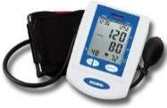
2018 Health Plan
New Plan with HealthPartners for 2018!
What is not changing (cont’d)?
Changes during Annual Open Enrollment or within
30 days of life event
Spouse Fee ($90) – Spouse Medical Statement form
Due November 18 for new spouses added for 2018
Proof of Dependent Eligibility required for new dependents added
to health (dental and/or vision) plan for 2018

Slide 13

2018 Health Plan
New Plan with HealthPartners for 2018!
Health Plan Wellness Rewards
Employee/Spouse complete HRA and show they are up to date with preventive screenings (Consent Form or Wellness Statement)
Employee will move to lower premium (Bronze, Silver or Gold) with
PBA dollars ($550/$1100)
1) Annual HRAs* (Aug. 1 – Oct. 13)
Late HRA (Sept. 1 – Oct. 13, with $65 Fee) information on
BellinBenefits.org, 2018 Benefit Information Page
  *Employees/spouses that completed an HRA in 2017 (prior to August 1st) do not need to complete another, unless they wish to do so. Last HRA score will be used.
2) Consent Form –Due October 13, 2017 (unless completed last year)
OR
Wellness Statement – Due November 17, 2017
(unless already completed in 2017)
More information at BellinBenefits.org,
(2018 Benefit Information)!

Slide 14
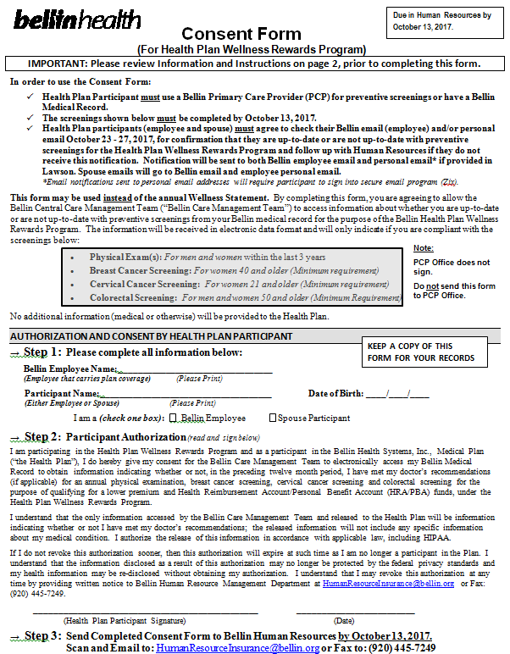
Consent Form
May be used to show employee/spouse is up-to-date with preventive screenings on the Wellness Statement.
Only employee/spouse signs
Information will confirmed electronically from the data in Bellin medical record
Employee/Spouse will be notified via secure email that they are up-to-date or not up-to-date with preventive screenings (Bellin email and personal email, if in Lawson ESS).
Consent Form is due October 13, 2017 (Data only verified one time)
Form will only need to be signed once (will continue until revoked)
To use Consent Form:
Must use Bellin PCP for preventive screenings or have a Bellin medical record
Must be up-to-date with preventive screenings on October 13, 2017
Must have email (for notification)
Available at BellinBenefits.org, (orange box, Consent Form and 2018 Wellness Statement).

Slide 15
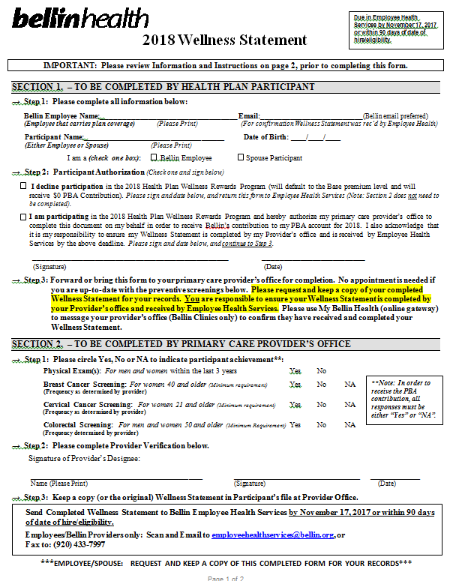
2018 Wellness Statement
All employee/spouses enrolled in the 2018 health plan that do not submit a Consent Form* will need to submit a Wellness Statement indicating:
They are participating in the Health Plan Wellness Rewards (Provider’s office must complete the bottom), OR
They are declining participation in the Health Plan Wellness Rewards Program (will not have their Provider’s office complete form).
2018 Wellness Statements** are due by November 17, 2017.
*If employee/spouse did a Consent Form last year, they do not need to do again this year.
**If employee/spouse already completed a Wellness Statement during 2017, they do not need to do a 2018 Wellness Statement.
Available at BellinBenefits.org, (orange box, Consent Form and 2018 Wellness Statement).

Slide 16

2018 Health Plan
New Plan with HealthPartners for 2018!
Health Plan Wellness Rewards (cont’d)
3) Reasonable Alternative Standard (RAS) Activity
Complete to earn back HRA points lost and move up
to the Silver or Gold premium level
(Must be in the Bronze or Silver premium level to use a RAS)
For 2018, no longer need PCP visit before and after RAS Activity.
Employee/spouse will receive RAS Certificate form RAS Activity Leader and then send it to Healics.
See Reasonable Alternative Activity (RAS) Information on BellinBenefits.org!
CHANGE

Slide 17

2018 Health Plan
New Plan with HealthPartners for 2018!
What is changing?
Two Tiers of In-Network Providers:
Tier 1 = Bellin and ThedaCare ACO Networks
Tier 2 = Aurora, Froedtert, Children’s Hospital,
UW Hospital, Mayo and Cigna Wrap (HealthPartners)
Tier 3 (Out-of-Network Providers) = Provider not in HealthPartners Cigna
Wrap, Prevea and HSHS (St. Vincent’s/St. Mary’s)
Participants do not need to choose a Bellin PCP
Participants do not need insurance referrals to see specialists
Annual preventive visits paid at 100% with all Tier 1 and Tier 2 providers
Annual mammogram benefit will be billed to insurance (if employee has insurance)

Slide 18

2018 Health Plan
New Plan with HealthPartners for 2018!
Premium increases for 2018:
  Average increase for single, full-time = + $ 2.94 per pay period
  Average increase for family, full-time = + $ 9.18 per pay period
  Average increase for single, part-time = + $ 4.68 per pay period
  Average increase for family, part-time = + $15.18 per pay period
Employees total share of cost is less, but premiums must increase to cover total estimated funding.

Slide 19

2018 Health Plan
New Plan with HealthPartners for 2018!
Prescription Coverage Changes for 2018:
What is changing?
Moving from OptumRX to HealthPartners
Formulary Plan
Three copay levels, Generic (lowest cost), Brand (higher cost) and
Specialty
What is not changing?
Mail Order and Specialty pharmacy services available
Bellin and Shopko – still best cost

Slide 20


2018 Dental Plan
  New Plan Administrator - HealthPartners for 2018!
  No change in plan design for 2018
    Open Plan (any provider), coverage based usual,
    reasonable and customary charges,
    OR
    Use HealthPartners In-Network Providers
  Wellness Reward: Lower premium if preventive services were
  completed by employee and spouse (if enrolled) in 2017
    Preventive Dental services will be reported by UHC for 2017 – no Preventive
    Dental Form needed, if employee/spouse on Bellin’s Dental Plan in 2017
    Preventive Dental Form due November 17, 2017 for new enrollees for 2018
More information at BellinBenefits.org,
(2018 Benefit Information)!

Slide 21

2018 Dental Plan
  New Plan Administrator - HealthPartners for 2018!
  Increase in premiums for 2018
    Average increase for single, full-time = + $ .33 per pay period
    Average increase for family, full-time = + $ .96 per pay period
    Average increase for single, part-time = + $ .53 per pay period
    Average increase for family, part-time = + $ 1.53 per pay period

Slide 22

2018 Dental Plan
  New Plan Administrator - HealthPartners for 2018!
Changes during Annual Open Enrollment or within 30 days of life event
Proof of Dependent Eligibility required for new dependents added
to dental (health and/or vision) plan for 2018 – See information at
BellinBenefits.org (2018 Benefit Information).
More information at BellinBenefits.org,
(2018 Benefit Information)!

Slide 23
2018 Benefit Review
  2018 Health and Dental Plan Review
  with HealthPartners
More information at BellinBenefits.org,
(2018 Benefit Information)!

Slide 24
2018 OPEN ENROLLMENT
Plans for a healthier you

Slide 26
Today, you’ll
Get an overview of your plan options
Understand your coverage and benefits
Learn how HealthPartners supports you

Slide 27

Deductible plan
You split costs with insurance
Your plan kicks in after you pay a certain amount. That’s your deductible.
Your deductible
You pay 100% of costs
Notes:
When it comes to a deductible plan, let’s start with the obvious question:
What’s a deductible?
A deductible is a set amount you’re in charge of paying before your plan kicks in. You cover costs up to that amount.
After that, your plan will split the bill with you. That’s called coinsurance. For example, you might pay 20 percent and your plan would cover 80 percent.
Once you reach a limit, known as your out-of-pocket maximum, you don’t pay any more. All in-network care is paid for by your health plan.

Slide 28

Deductible plan

You’re covered.
Preventive care
Convenience and online care
Specialty care
Prescriptions



Notes:
Your plan will pay for some services at no cost to you. They’re called preventive care. You can get your yearly checkup, vaccines and screenings without having to worry about paying your deductible.
Here are a few things your plan will help with after you reach your deductible:
Convenience and online care
Specialty care (no referrals needed)
Prescriptions

Slide 29


Primary-Specialty plan
$
$$$
Primary care Specialty care
Family practice
Pediatrics
Internal medicine
Chemical and mental health
Cardiology
Dermatology
OB/GYN
Ear, nose and throat (ENT)
Notes:
The amount you pay changes depending on what type of doctor you see. You’ll pay more for a specialist and less for a primary care doctor.
Some examples of primary care doctors are:
Family practice
Pediatrics
Internal medicine
Chemical and mental health
Some examples of specialty care doctors are:
Cardiology
Dermatology
OB/GYN
Ear, nose and throat (ENT)

Slide 30

Care today for a healthier tomorrow
Regular checkups keep people happy and healthy.”
Alcohol, tobacco and weight screenings
Blood pressure, diabetes and cholesterol tests
Breast, cervical and colorectal cancer screenings
Routine pre- and post-natal care
Vaccines
Well-child visits
healthpartners.com/preventive
Notes:
Getting regular preventive care helps keep you healthy. In fact, people who get the preventive care that’s recommended for them are more likely to stay healthy for years to come.
Some things that count as preventive care:
Alcohol, tobacco and weight screenings
Blood pressure, diabetes and cholesterol tests
Breast, cervical and colorectal cancer screenings
Routine pre- and post-natal care
Vaccines
Well-child visits
Visit healthpartners.com/preventive to find out what you should be checked for. Or just ask your doctor.

Slide 31



HRA (PBA)plan
Use the money in your HRA to pay for your health expenses.”
HRA
Money from your employer
Use when you get care
Notes:
A health reimbursement account (HRA) helps plan for the future. Your employer gives you money to help cover your health expenses. The money is saved away in your HRA.
Think of an HRA as a special spending account for your medical costs. Check with your employer to figure out what expenses are eligible and how much money they’ll give you.
So, how does this plan work?
This plan has a deductible. That’s what you’re in charge of paying before your plan helps cover costs. After that, you’ll pay a portion of the bill, called coinsurance. For example, you might have to pay 20 percent and your plan will cover the rest.
The thing to remember is you use the money in your HRA to help pay for your health expenses. That could be for bills before or after you reach your deductible.

Slide 32

You see your doctor
Your doctor sends us the claim form
The HRA/PBA is direct paid to the Provider
Your employer puts money into your HRA
HRA (PBA) plan
Notes:
When you see a doctor in your network, the claim is automatically sent to HealthPartners. You don’t need to fill out any paperwork or file a claim! HealthPartners will send you a check, or you can sign up for direct deposit. If you see a provider that is not in the network, you’ll need to pay your bill. You can then send in a claim to be paid by your HRA.

Slide 33



Prescription coverage
Savings tip: Check your drug list and choose generics when possible!”
How to read your formulary
Covered
Might be covered but costs more
Not covered
healthpartners.com/preferredrx
Notes:
Knowing if your health plan will cover your medicine and how much you’ll pay is important. We make it easy to help you find out and save money:
1. Start by checking your drug list
A formulary is a fancy word for a list of covered drugs. Your formulary is called PreferredRx.
2. Icons next to each medicine help you read the formulary.
Medicines with an F are formulary drugs that are covered.
Medicines with an NF are non-formulary drugs that might be covered, but will cost more.
Medicines with an X are excluded medicines that aren’t covered.

Slide 34
Pharmacy benefits
 | Tier I | Tier II
Generic formulary | $10 copay at Bellin & Shopko | $15 copay at all other network pharmacies
Brand formulary | $30 copay or 35% whichever is greater, up to a $135 max per script at Bellin & Shopko | $40 copay or 40% whichever is greater, up to a $150 max per script at all other network pharmacies
myMailRx (mail order pharmacy) | $25 generic copay; $75 brand copay or 35%, whichever is greater, up to a $405 max
Specialty | $200 copay
Notes:
See SBCs

Slide 35
Provider Network Levels
COVERAGE LEVEL | COST
In-Network, Tier 1 Bellin & ThedaCare | $
In-Network, Tier 2 Aurora, Froedert, Children’s Hospital, UW Hospital, Mayo & Cigna | $$
Out-of-Network (including Prevea and HSHS (St. Vincent’s/St. Mary’s) | $$$
Notes:
Benefit levels make it easy to choose a high quality doctor at the lowest cost.
All the doctors we partner with are excellent. But some have a better effect on your health and wallet. Based on patient surveys, claims info and overall health care data, we bucket doctors into three benefit levels. Benefit level one docs consistently have happier, healthier patients at a lower overall cost. Choose them to get the best bang for your buck.
You can go to healthpartners.com/distinctions3-2018 to check out what level each doctor is in. Or call Member Services and they’ll help you figure it out.

Slide 36
Your plan
 | Tier I | Tier II | OUT-OF-NETWORK
Deductible | $2,000 per person; $4,000 per family |  | $4,000 per person; $8,000 per family
Out-of-pocket maximum | $4,000 per person; $8,000 per family |  | $8,000 per person; $16,000 per family
Preventive care | 100% coverage |  | 50% coverage after deductible
Office visit | 85% coverage after deductible for primary care; 75% coverage after deductible for Specialty care | 60% coverage after deductible for primary care; 60% coverage after deductible for Specialty care | 50% coverage after deductible
Convenience care | 100% coverage at for Bellin FastCare and Virtual Visits; Other: 85% coverage after deductible | 60% coverage after deductible | 50% coverage after deductible
Urgent care | 85% coverage after deductible |  | 50% coverage after deductible

Slide 37
Your plan
 | IN-NETWORK |  | OUT-OF-NETWORK
Inpatient hospital | 85% coverage after deductible | 60% coverage after deductible | 50% coverage after deductible
Outpatient hospital | 85% coverage after deductible | 60% coverage after deductible | 50% coverage after deductible
Emergency | 85% coverage after deductible | 85% coverage after deductible | 85% coverage after deductible
Durable medical equipment | 85% coverage after deductible | 60% coverage after deductible | 50% coverage after deductible

Slide 38

virtuwell.com
Feel better, faster, with virtuwell.”
24/7 online care
  Simple, convenient and safe
  Treats more than 60 common conditions
  You’re only charged if we can treat you
  Never pay more than $45
Notes:
Who has time to be sick? Between all you have going on, I know it’s hard to fit in a trip to the doctor. But you don’t have to. We’ve got an easy way for you to get back to normal ASAP.
Head over to virtuwell.com. Our team of certified nurse practitioners can give you a diagnosis, treatment plan and even a prescription. All in about 30 minutes.
How does it work?
It’s easy. Visit virtuwell.com. Answer a few questions – anytime, anywhere.
It’s fast. In 30 minutes or less, a board-certified nurse practitioner emails and texts your treatment plan, including any prescriptions.
It’s guaranteed. You’re only charged if we can treat you. Have questions about your treatment plan? Unlimited follow-up calls are free. In the end, you’ll never pay more than $45.
Member Services can tell you if your plan will pay for some or all of your visit. Call them at 952-883-5000 or 800-883-2177.

Slide 39

Doctor On Demand
Feel better, faster, with Doctor On Demand.”
Treats head-to-toe conditions 24/7. doctorondemand.com
Pay up to $49 for the first 15 minutes you visit with a doctor. And $49 for each additional 15 minutes.
Notes:
Save time and money. Get care right from your smartphone, tablet or computer. Here’s an option your HealthPartners plan offers.
Video chat treating head-to-toe conditions that’s:
• Convenient. Get started when and where it works for you at doctorondemand.com. Video capabilities required.
• Quick. See a doctor in minutes. Live video visits include assessment, diagnosis and prescriptions when necessary.
• Affordable. Up to $49 for the first 15 minutes. And $49 for each additional 15 minutes.
Member Services can tell you if your plan will pay for some or all of your visit.

Slide 40
2018 OPEN ENROLLMENT
Your partner in dental health

Slide 41



Understanding your dental plan
I always tell people to consider these three things when signing up for a plan.”
Know what you might have to pay
Find where
you can go
Use your account to keep up all year
Notes:
Having healthy teeth is important to your overall health and well-being. And that’s why choosing a dental plan is so important.
Here are three ways to break it down:
What you might have to pay
Premium (you can definitely expect this one) – how much you pay for your dental plan. It’s typically taken out of your paycheck. Best case, you have healthy checkups and cleanings and only pay your premium all year.
Deductible – the amount you have to pay before your plan pitches in (not counting your premiums). If your deductible is $50, your plan won’t pay for your care until you’ve paid $50.
Coinsurance – a percent of the cost you’re in charge of paying. For example, you might be responsible for 20 percent of a filling’s cost and your plan will cover the rest.
Out-of-pocket – all costs you’re in charge of paying after you reach your annual maximum. The annual max is the total amount your plan will pay for the year.
Finding where you can go
Can you see your favorite dentist and still get the best deal? You’ll generally pay the least when you get care that’s in network. Our website makes it easy to search for a dentist in your network. Visit the website listed in your plan overview.
Keeping up year round
A myHealthPartners account can help you feel confident when you need care. You can see recent claims, check where you’re at with your deductible and annual maximum, and more.

Slide 42

Dental Open Access plan
Preventive dental services
Extra exams and cleanings
(if you’re pregnant or have diabetes and are at risk for gum disease)
Pick the dentist you want to see, and open wide!”
Remember
Dental plan annual maximum = the most your plan will pay for dental care each year
Notes:
Did you know the average person spends $685 on dental care each year?* There’s good news though. Your dental plan can help keep a lid on costs and make you feel good from teeth to toes.
With the HealthPartners® Dental Open Access plan you get:
Preventive dental services covered 100 percent
Extra exams and cleanings covered 100 percent if you’re pregnant or have diabetes and are at risk for gum disease
If you need extra work, like getting a cavity filled, you may pay a deductible (an amount you have to pay before your plan helps with the cost) or coinsurance (a percent of the bill).
And remember that your dental plan has an annual maximum. It’s a bit different than your medical plan. Your dental plan maximum is the most your plan will pay for your dental care each year. You’re in charge of the rest.
*Healthy Policy Institute. “The Per-Patient Cost of Dental Care, 2013: A Look Under the Hood,” American Dental Association, March 2016.

Slide 43
Your dental plan
 | IN-NETWORK | OUT-OF-NETWORK
Deductible | $75 individual $150 family
Annual maximum | $1,000
Preventive and diagnostic care | 100% | 100% of Customary, Usual and Reasonable
Notes:
See SOBs

Slide 44
Your dental plan
 | IN-NETWORK | OUT-OF-NETWORK
Basic care | 80% coverage after deductible; 50% coverage after deductible for posterior composite fillings | 80% coverage* after deductible; 50% coverage* after deductible for posterior composite fillings
Special care | 50% coverage after deductible | 50% coverage* after deductible
Prosthetics | 50% coverage after deductible | 50% coverage* after deductible
Orthodontic services | 50% coverage to a lifetime max of $1,250 | 50% coverage* to a lifetime max of $1,250
*of Customary, Usual and Reasonable cost
Notes:
See SOBs

Slide 45
Extra dental care if
you need it
Get extra dental care covered for free if you need it.”
Diabetic or pregnant?
  No deductible, no coinsurance
  Simply see an in-network dentist
  Diseases caught early save time and money!
100%
Coverage on network dental services for people who are pregnant or have diabetes and are at risk for gum disease
Notes:
Did you know that people who are diabetic or pregnant are at greater risk of gum disease? It’s true. Gum disease can makeit harder to manage your diabetes or to have a healthy pregnancy.That’s why if you’re pregnant or have diabetes and are at risk for gum disease, you get extra dental care covered at 100 percent.
There’s no deductible or coinsurance. Your plan will pay even if you’ve already reached your annual maximum for the year. Just see an in-network dentist. You’ll also be happy to know that extra dental care can help you save money and time. If a dentist catches a disease early,it can be much easier to treat by your doctor. Isn’t that something to smile about?

Slide 46
Here for you 24/7
Member Services | Help with all things related to your plan Mon – Fri, 7 a.m. to 7 p.m., CT
CareLineSM service nurse line | Trusted nurse advice 24/7, 365 days a year
BabyLine phone service | Expert guidance on your pregnancy or new baby 24/7, 365 days a year
Nurse NavigatorSM program | Support in managing your care Mon – Fri, 8 a.m. to 5 p.m., CT
Pharmacy Navigators | Help with your medicines Mon – Fri, 8 a.m. to 5 p.m., CT
Behavioral Health Navigators | Help with mental or chemical health benefits Mon – Fri, 8 a.m. to 5 p.m., CT
We’re here to help you be your healthiest you.”
Notes:
At HealthPartners, we love to help people live their healthiest lives. Call us when you have questions about your health or what your plan covers.
Call Member Services for questions about:
Your coverage, claims or account balances
Finding a doctor, dentist or specialist in your network
Finding care when you're away from home
Health plan services, programs and discounts
Call the CareLineSMservice nurse line when you’re wondering about:
Whether you should see a doctor
Home remedies
A medicine you’re taking
Use the BabyLine phone service to get support with:
Your pregnancy
The contractions you’re having
Your new baby
Member Services can also help you:
Talk to a Nurse NavigatorSMfor help with:
Understanding your health care and benefits
How to choose a treatment
Talk to a Pharmacy Navigator with questions about:
Your medicines or how much they cost
Doctor approvals to take a medicine (prior authorization)
Your pharmacy benefits
Transferring medicine to a mail order pharmacy
Contact a Behavioral Health Navigator when you need help with:
Finding a mental or chemical health careprofessional in your network
Your behavioral health benefits

Slide 47


Your health on the go
See recent claims and how much you owe
Get the help you need, even after hours.”
Get estimates, specific to
your plan
Check your balances
Search for doctors or clinics
View and fax your member
ID card
Notes:
Want to check on a claim? Need to find an urgent care near your house? These are just a couple of the things you can do on your myHealthPartnersaccount and the myHP mobile app.
Here are the top five things members find most helpful with their online account or mobile app:
See recent claims and how much you owe for your health care.
Search for doctors in your network or near your current location.
Get cost estimates for treatments and procedures, specificto your plan.
Check your balances, including how much you owe before yourplan starts paying (deductible) and the most you’ll have to pay (out-of-pocket maximum).
View your HealthPartners member ID card and fax it to yourdoctor’s office

Slide 48



Get help with
your medicine
Your health plan has lots of ways to manage your medicines too.”
Talk to a pharmacy
navigator
Learn more online
Get your meds shipped to your door
healthpartners.com/pharmacy
Notes:
Our teams and tools are here to help you find the right medicines toachieve your best health. Here are just some of the ways we’re here to help:
Talk to a pharmacy navigator
Are there manufacturer coupons available for my prescriptions? What other formulary options are there?
Learn more about your medicine online
Visit healthpartners.com/pharmacy. The health library has information on how to take your medicine, what it should look like, what to do if you miss a dose and more. And our Drug Interaction Checker will let you know what food ordrinks to avoid. You can also learn about other options if your medicines don’t work well together.
Get medicine delivered to your door
With Mail Order Pharmacy, your medicine gets shipped right to your door, within five days. Shipping is free. Isn’t that great?

Slide 49

Healthy choices = hefty savings
A little support – and savings – can help you be healthy.”
Eyewear
Swim lessons
Recreational equipment
Healthy mom and baby products
Healthy eating delivery services
And more!
healthpartners.com/discounts
Notes:
We all know what a difference being healthy can make in your life and how a little support – and savings – can be a big help. That’s why I’m excited to tell you about some great healthy discounts you get just for being a HealthPartners member.
You can save money on:
Eyewear
Fitness and wellness classes
Healthy eating programs and delivery services
Healthy mom and baby products
Orthodontics
Recreational equipment
Spa services
Swim lessons
And more!

Slide 50


Assist America
With Assist America, you don’t have to worry. You’ve got support for the unexpected.”
24/7 help when you’re traveling
Download the Assist America mobile app
Notes:
If you’re jet-setting across the world or just heading out of town for the weekend, you don’t have to worry. We’ve partnered with Assist America so you can get the support you need if the unexpected happens.
When you’re traveling more than 100 miles away from home and have an emergency, Assist America is available 24/7/365. They can help you with:
Filling lost prescriptions
Finding quality care
Hospital admission
Pre-trip info, like immunizations you need
Sending health updates home
Tracking down lost luggage
Translator referrals
Coordinating transport to care facilities or back home

Slide 51
THANK YOU!
Questions?
Member Services:
952-883-7000 (7AM-7PM, M-F)
866-443-9352 (7AM-7PM, M-F)

Slide 52

2018 Vision Plan
  Vision
  Plan provided by NVA – no change for 2018
  No change in plan design for 2018
  No change in premiums for 2018
  Changes during Annual Open Enrollment or within
  30 days of life event
  Proof of Dependent Eligibility required for new dependents
  added to vision (health and/or dental) plan for 2018
More information at BellinBenefits.org,
(2018 Benefit Information)!

Slide 53



2018 Flex Spend Plan
  Flex Spend
  Plan provided by Employee Benefit Corporation (EBC)
  – no change for 2018
  Medical and Limited* Flex Spend ($2,600 max)
    Benefits Card (current cards are reloaded for 2018 – do not discard)
    $500 annual rollover
    *Reminder: Medical Flex used for Medical, Dental and Vision expenses
    Limited Flex used for only Dental and Vision expenses.
    (Don’t choose Limited Flex unless you/your spouse are actively
    contributing to a HSA (Health Saving Account) outside of Bellin)
  Dependent Care Flex Spend ($5,000/family max)
  Online access / mobile app
  Plan carefully and review your election during Open Enrollment!
  (Flex cannot be canceled/changes cannot be made to Flex Spend during the
  Plan Year, except in a few specific situations)
CHANGE
More information at BellinBenefits.org,
(2018 Benefit Information)!

Slide 54
2018 Voluntary Life – New Benefit
  Voluntary Life Insurance will be offered
  during Open Enrollment for 2018
  Benefit effective January 1, 2018
  Provided by UNUM (current employer paid Life, STD and LTD provider)
  Employees may purchase coverage for themselves, spouse
  and dependents (Benefit available in set increments, with
  established limits)
  Employees that elect minimum coverage for 2018 will not
  need to complete EOI to enroll themselves/spouse/dependents during
  future enrollment
  Information meetings (just for Life Insurance) will be held Sept. 19 – 22
  Plan to Attend a Meeting! (meetings also available via webinar)
More information at BellinBenefits.org,
(2018 Benefit Information)!

Slide 55
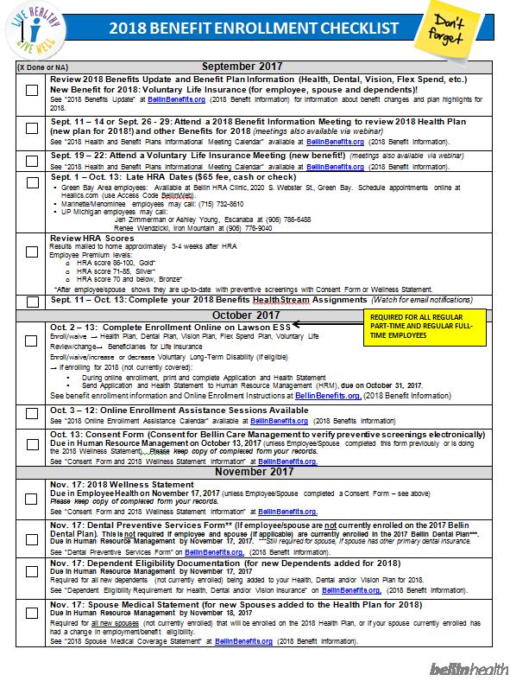

Worried about forgetting something?
Use the 2018 Benefits Open Enrollment Checklist.
Keep track of important actions/dates.
Available at BellinBenefits.org (2018 Benefit Information).

Slide 56

2018 Annual Open Enrollment
October 2 – October 13
All regular part-time and full-time employees (.5 - 1.0 FTE) need to complete enrollment whether enrolling or declining on Lawson ESS
Postcard and email reminder week of October 2nd
Open Enrollment Assistance Sessions (see calendar for date/times on BellinBenefits.org (2018 Benefit Information)
Online Enrollment Instructions available on BellinBenefits.org (2018 Benefit Information) on October 2nd.

Slide 57
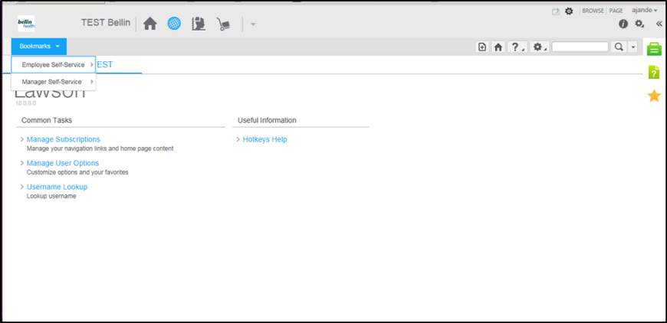
2018 Annual Open Enrollment
Use the Lawson ESS button link at the bottom of BellinBenefits.org to get to Lawson.
Sign into Lawson ESS and go to Lawson Employee Self-Service (ESS) under Bookmarks here.

Slide 58
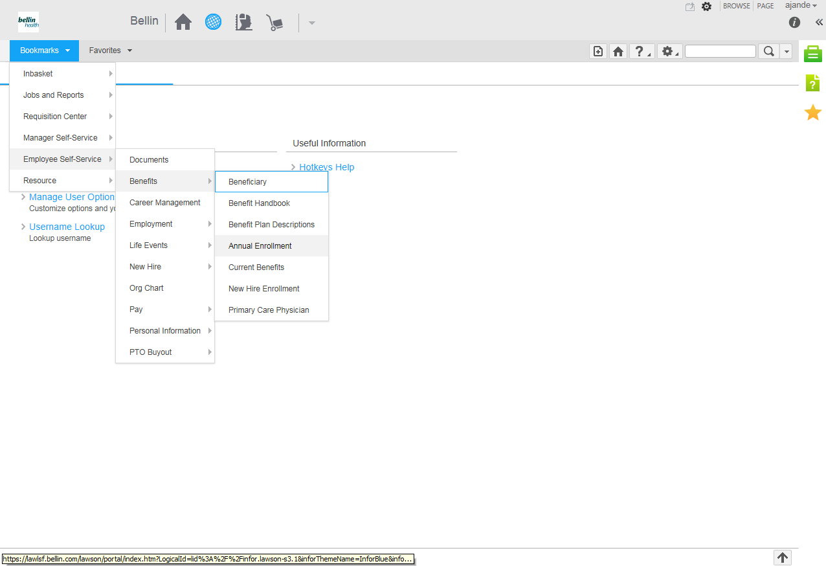
2018 Annual Open Enrollment
Go to “Annual Enrollment”.
Instructions for Online Enrollment will be available on BellinBenefits.org on October 2nd.

Slide 59

2018 Benefits - Other Items
  Upcoming Communications:
  Open Enrollment Reminder
  (Postcard and email notifications to employees)
  2018 Benefit Health Stream Assignments (Sept. 11 – Oct. 13)
  Weekly updates on Julius/BellinBenefits.org
  Email blasts (benefit highlights/deadline reminders)
  Scavenger Hunt on BellinBenefits.org - complete
  Survey Monkey Questions about 2018 Benefits for
  chance to win gift basket/prizes! Watch for information
  on Julius and BellinBenefits.org week of September 11th.

Slide 60

2018 Benefit Review
  Questions?

